Slide 1
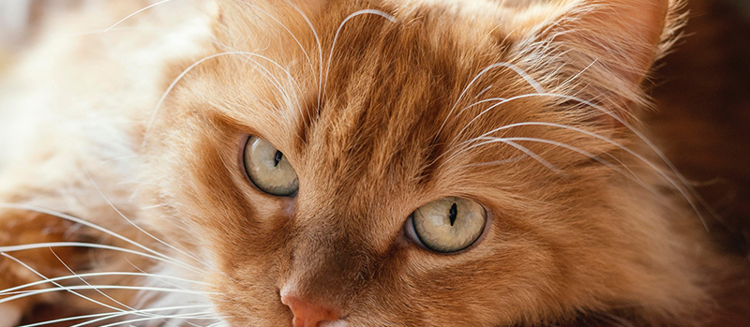
7 signs of a healthy cat
Insert Article

Slide 2
